Slide 1
New Assessment Coordinator Workshop: English Learners
August 30, 2017

Slide 2
Goals
Identification Process
Home Language Survey
Screening
Parental Notification
Infinite Campus
Language Acquisition Plan (LAP)
Services
Annual Summative Assessment
Finding Reports and Data
Available Resources

Slide 3
Identification Process
Screening
Parent Notification Letter
Infinite Campus
Home Language Survey

Slide 4
Important Timelines
The identification process MUST take place…
30 days from the beginning of the school year (ESEA Section 11.12 (A))
Or 2 weeks after enrollment if student arrives after the beginning of the year

Slide 5
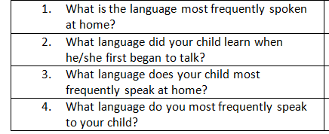
Identification
Home language survey
- given to ALL new students
Four questions
http://doe.sd.gov/oess/TitleIIIela.aspx

Slide 6
What is WIDA?
World-Class Instructional Design and Assessment
A consortium of states dedicated to the design and implementation of high standards and equitable educational opportunities for English Learners
South Dakota is 1 of 39 states that are members of the WIDA consortium

Slide 7
WIDA Consortium
Kindergarten W-APT (screener)
WIDA Screener
ACCESS for ELLs 2.0
Alternate ACCESS
KG ACCESS
Professional Development
ELP Standards

Slide 8
WIDA Identification Assessments
Kindergarten W-APT
Paper-based
One-on-one administration
WIDA Screener 1-12
Online
Same technology as ACCESS for ELLs 2.0
Training required to become certified

Slide 9
South Dakota Entrance Criteria
SD EL entrance criteria
KG: Refer to DOE provided guidance
Grades 1-12: Screener score < 5.0

Slide 10
Annual Parent Notification Letter
Required under Title I and Title III requirement
Sample letter available on SDDOE Title III webpage

Slide 11
Infinite Campus
IMPORTANT data elements in Infinite Campus
First Year in Country
EL Designation

Slide 12
First Year in Country Criteria
Must be an identified EL student, who has attended schools in the United States (not including Puerto Rico) for less than 12 months
Must take ACCESS 2.0 if enrolled during testing window to get the first year exemption from the ELA portion of SD Summative Content Assessment (Smarter Balanced)
If student arrives after ACCESS 2.0 the school needs to administer the KG W-APT or Screener
If this criteria is met, student is excused from ONE administration of ELA SD Summative Content Assessment
Student takes Math & Science, but results only count for participation in the first year. Scores are not included in accountability

Slide 13
First Year in Country
The first year in country will be considered if a student is EL and first entered the United States between May 2 of the previous spring (Spring of 2016) and May 1 (Spring 2017) of the current year.
Schools must indicate ALL 3 options:
Date Entered U.S
Date Entered U.S school
First Year in Country box

Slide 14
EL Home Primary Language and Date Entered US School fields are populated on the student’s Demographics tab. This must be completed prior to entering EL information of the EL tab.

Slide 15
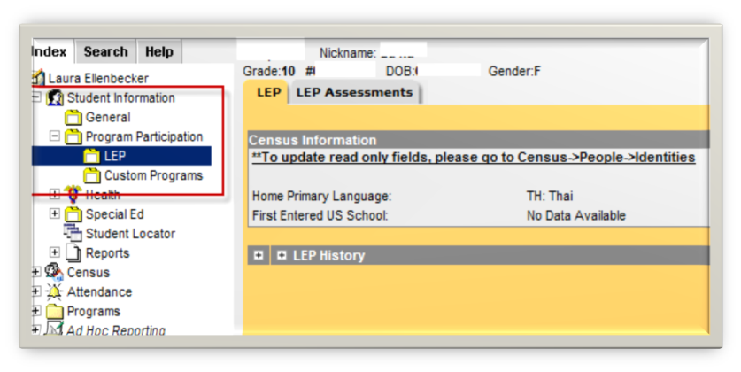
Where is the EL tab?
Index Student Information Program Participation EL

Slide 16
EL Tab Continued…

Slide 17
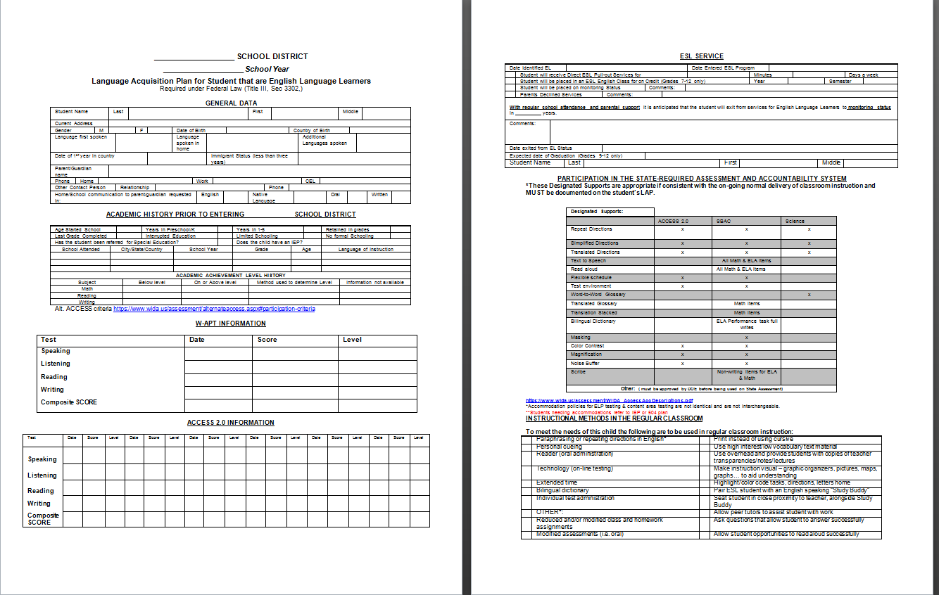
Language Acquisition Plan
Updated annually
Sample found on the
SDDOE Title II website

Slide 18
EL Services
What does my school need to do?
Determine students’ needs for EL services
Communicate with parents’ home language if needed or applicable
Provide Core EL program
Ensure EL students have equal access to ALL programs

Slide 19
Core EL Program
Are staff properly trained/certified?
Is the program research-based?
Is the school monitoring effectiveness of program?
Has every EL student been assured of equitable participation in All programs?

Slide 20
WIDA Website
W-APT Screener Test Docs & Webinar
Training Course
Preparation Resources
Educator Resources
KG & ALT Access Information
ELD Standards
Can-Do Descriptors
Sample Items
Manuals
Recorded webinars

Slide 21
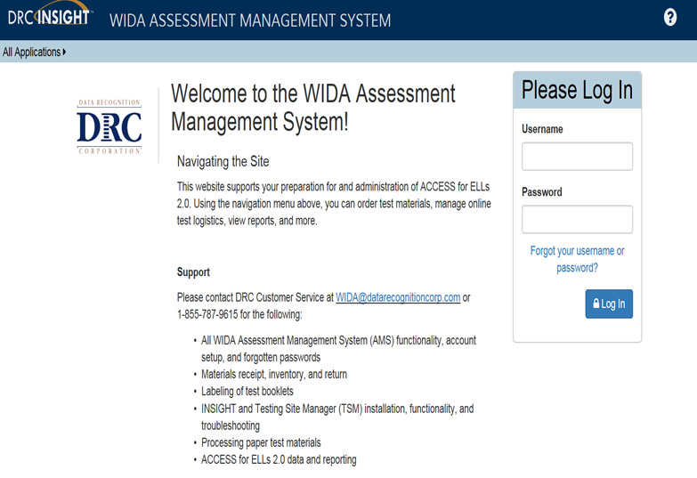
WIDA AMS
Set up Test Administrator and Technology Coordinator accounts
Designate permissions for users
Select needed accommodations
View Reports
View & Print test tickets
Create test sessions
Use system to view technology preparation materials
Such as user guides & technology web-based modules
Download testing software from the system

Slide 22
Training Course
Secure
Each assessment has a separate training component
May be completed in one-sitting, or in as many sessions as necessary
One-two weeks prior to first administration of test

Slide 23
WIDA Screener
Quiz | Certification
Speaking Grade 1-5 Quiz | WIDA Screener, Speaking Test, Grades 1-5
Speaking Grades 6-12 Quiz | WIDA Screener, Speaking Test, Grades 6-12
Writing Grades 1-5 Quiz | WIDA Screener, Writing Test, Grades 1-5
Writing Grades 6-12 Quiz | WIDA Screener, Writing Test, Grades 6-12
Quizzes must be passed with an 80% or higher to become certified to give the WIDA Online Screener

Slide 24
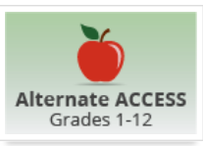
KG & Alt. ACCESS
Training pages and videos
Kindergarten Quiz
80% or higher
NEW: must take quiz annually
Training pages and tutorial
Alternate Quiz
80 % or higher
Only need to complete this training if administering this test

Slide 25
ACCESS for ELLs 2.0 Online
Test preparation and administration tutorials
NEW: Online Administration Quiz
80% or higher

Slide 26
English Learner Summative Assessments
Secure large-scale English language proficiency assessment
Administered to identified English learners in grades K-12

Slide 27
ACCESS for ELLs 2.0
Grades 1-12
Online
ACCESS for ELLs 2.0
Can be administered in a group setting
Staged Adaptive

Slide 28
Alternate ACCESS
Unchanged
Paper-based
Participating students must have a Significant Cognitive Disability
Taking an Alternate State Content Assessment documented in an IEP (alternate curriculum)
Participation Criteria
Alternate ACCESS for ELLs

Slide 29
Kindergarten ACCESS
Unchanged
Paper
Individually administered
Includes manipulatives
ALL components scored by Test Administrator during test administration
Kindergarten ACCESS for ELLs

Slide 30
Annual Summative Assessment Timelines
*Reference handout for a more detailed timeline

Slide 31
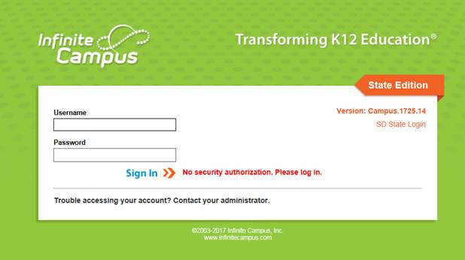
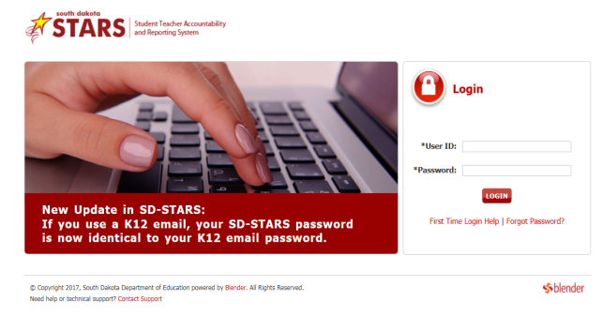
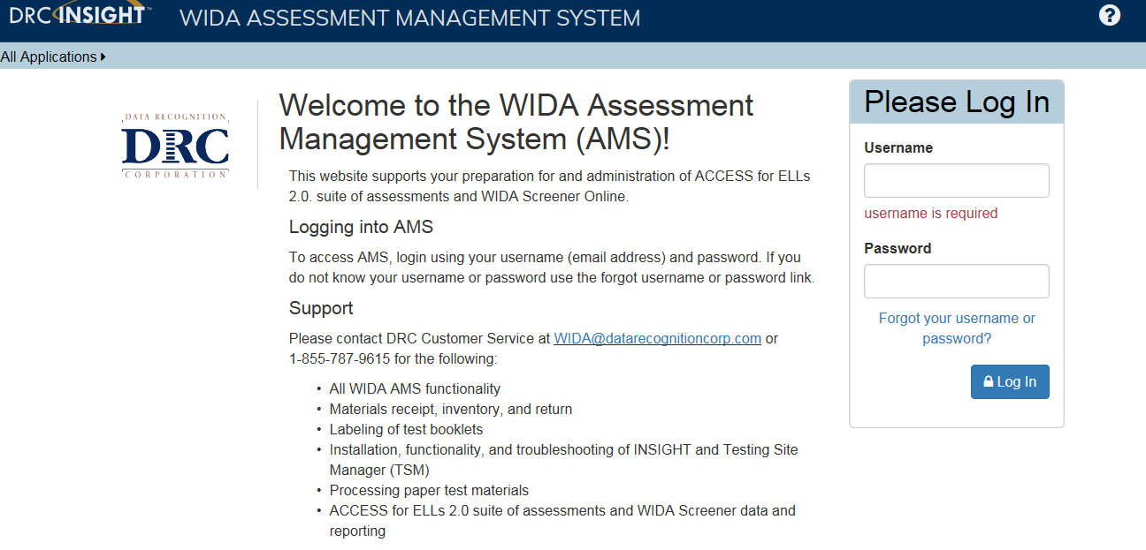
Reports and Data
Where to find it…
Infinite Campus
Assessment Tab – EL Tab
SD Stars
Reports Tab – Assessment Reports -
ACCESS Test Takers
WIDA AMS
All Application – Report Delivery –
On-Demand Reports

Slide 32
Reports and Data
Responsibilities for distributing and maintaining
File in student cumulative file
Share with student, their parents, and appropriate educational staff
District wide usage and monitoring of data to support and alter EL programs

Slide 33
Available Resources
WIDA website download library
SDDOE Title III website
SDDOE WIDA Assessments website
İColorín Colorado!

Slide 34
WIDA & DRC webinars
Free weekly webinars
Covers a range of pre, during, and post-testing topics
Organized to cover content relevant to particular roles
Webinar Schedule

Slide 35
Questions?

Slide 36
Who to Contact?

Slide 37
Yutzil Becker
Yutzil.Becker@state.sd.us
605.773.4698
Joe Moran
Joe.Moran@state.sd.us
605.773.3247

