Slide 1
MSAA Multi-State Alternate Assessment
New Test Coordinator Workshop
August 30, 2017

Slide 2
MSAA Overview
Multi-State Alternate Assessment or MSAA
Assesses English Language Arts (ELA) and Mathematics in grades 3-8, and 11
Alternate Assessment based on Alternate Achievement Standards (AA-AAS) through use of Core Content Connectors
Core Content Connectors (CCC) align to state’s content standards
Academic content designed to frame instruction and assessment of students with the most significant cognitive disabilities

Slide 3
MSAA
Grades assessed – 3-8 and 11 in Math and ELA (reading and writing)
Assessment will be online
4 tiers of questions
Teacher will complete 7 Trainings Modules prior to administering assessment
Test Coordinator complete 6 modules
Scripted assessment and one-on-one
Testing window March 19th through May 4th

Slide 4
Assessment Format
Selected Response – Student selects answer choice
Constructed Response – Students creates response
Open Response – Students communicate answer
Written Response – Student writing with appropriate supports

Slide 5
Who are your Alternate Assessment Eligible Students?
Notes:
Do you know if you have alternate assessment students (in or out of district placements)?

Slide 6
Identification
Ensure special education director and/or special education staff know about updated guideline criteria.
IEP team decision based on documented evidence
Student has a significant cognitive disability
The student is learning content linked to States Content Standards via Core Content Connectors (CCC)
The student requires extensive direct individualized instruction and substantial supports to achieve measureable gains in the grade-and age- appropriate curriculum

Slide 7
Accommodations
IEP Team will determine accommodations
Any accommodation used must be documented in the IEP.
Ideally, accommodations should guide day-to-day instruction, which allows a seamless transition to the assessment.

Slide 8
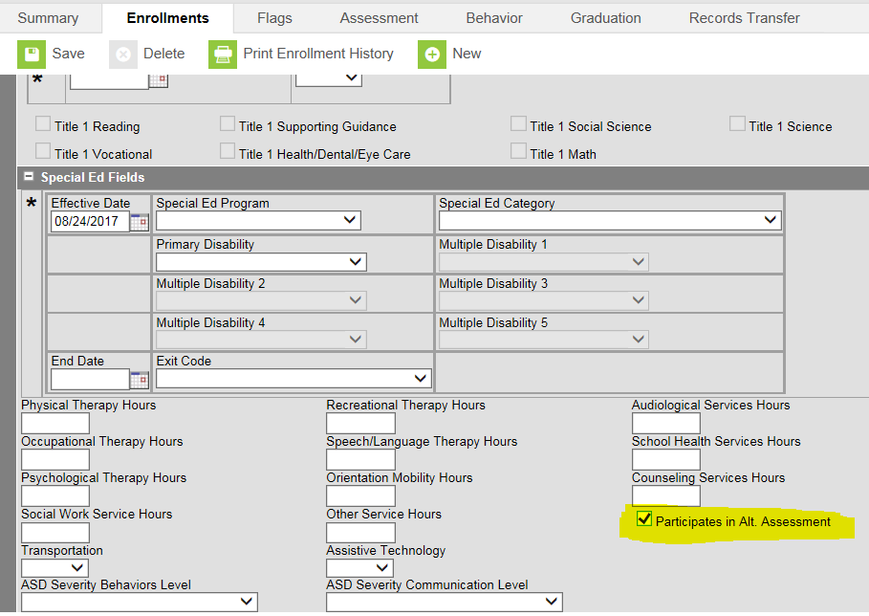
If Yes, student will take the Alt.
Staff notify the campus person.
Campus person will go the enrollment tab.
Check the box “Participates in the Alt Assessment”
Used for the Assessment Pull

Slide 9
Every Student Succeeds Act (ESSA)
Every Student Succeeds Act replaces ESEA starting in the 17-18 school year
Districts in the past are allowed to count 1% proficient scores of their tested population
ESSA changes so that the state is allowed to have 1% of their tested population participate in the alternate assessment in each content area (Math and ELA)

Slide 10
New: 1% Statewide Participation (ESSA Requirement)
Districts must use the criteria for alternate assessment participation.
If district has more than 1% participation, then they will need to submit justification to the state. It will be publicly reported.
Note: South Dakota is working on the justification requirements.
State will work with districts to evaluate and, if necessary, assist in reducing numbers.
Notes:
Past was 1% of the district’s tested student population could count toward proficiency from the alternate assessment.
Now 1% of the state population can participate. This means if districts

Slide 11
Who Is Responsible?
Test Coordinator
Test Administer
Provides oversight and ensures assessment is administered as intended.
Share with special education criteria and dates
Ensure data for the alternate assessment students are entered for the data pull
Pre-Assessment Modules
Pull reports from MSAA site
Certified and licensed teacher who works with student
Pre-Assessment Modules
Must pass with 80% accuracy
Will work one on one with student to complete the assessment
Complete assessment by May 4, 2018

Slide 12
Data

Slide 13
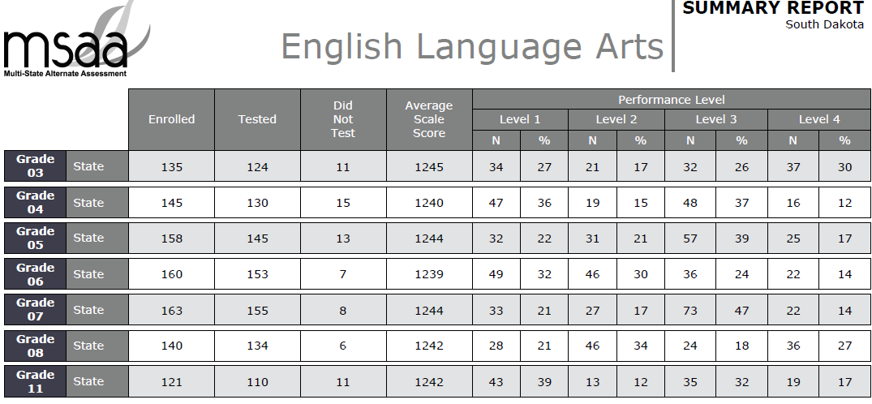
State MSAA ELA
* Includes BIE

Slide 14
State MSAA Math
* Includes BIE

Slide 15
SD Stars Reports
State Report Card
MSAA students are listed in the rooster
Scores in 1200
Special Education Reports
Accountability, Participation and Proficiency
South Dakota Assessment Portal
State, district, and school data
Individual student reports
Email christina.booth@state.sd.us to have District Coordinator account transferred to you if necessary

Slide 16
Resources
Significant Cognitive Disabilities: Instruction and Assessment

Slide 17
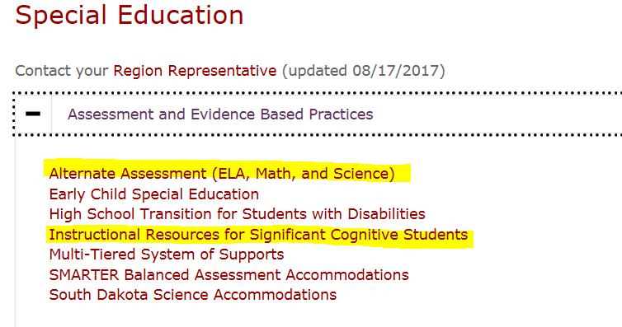
Important information

Slide 18
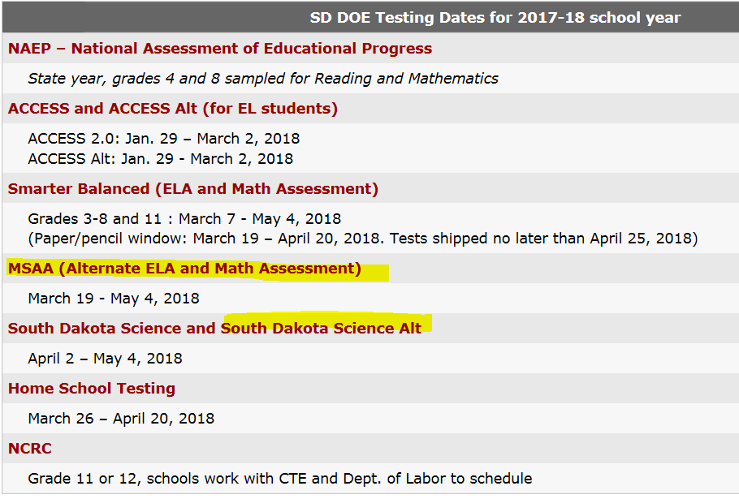
Another Route

Slide 19
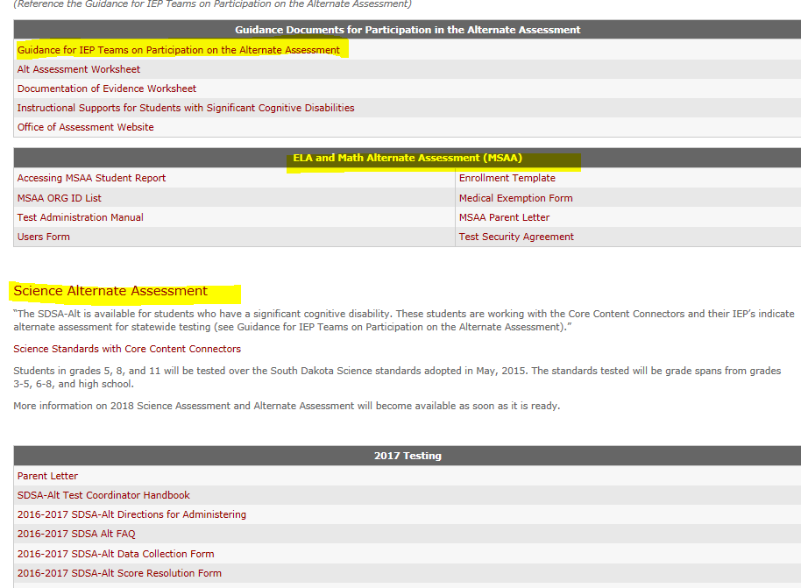
Alternate Assessment: http://doe.sd.gov/assessment/alternate.aspx

Slide 20
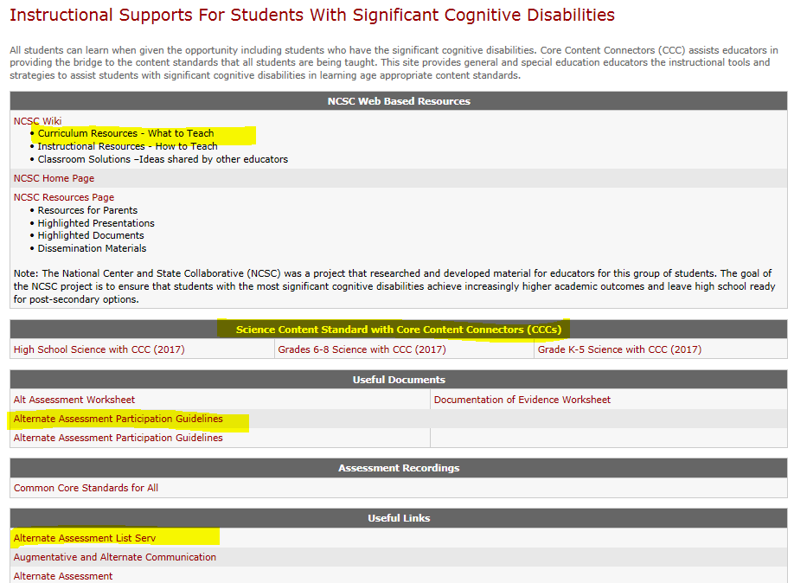
Instructional Supports for Students with Significant Disabilities: http://doe.sd.gov/oess/instructionalSCD.aspx

Slide 21
Alternate Assessments
Melissa Flor
Alternate Assessment Coordinator
Special Education Programs
Melissa.Flor@state.sd.us
605.773.6119

