Slide 1



South Dakota Principal Effectiveness Model
PE Webinar III
2/02/2023
Notes:
FOCUS: DOMAIN2

Slide 2

Domain Two
Instructional Leadership

Slide 3
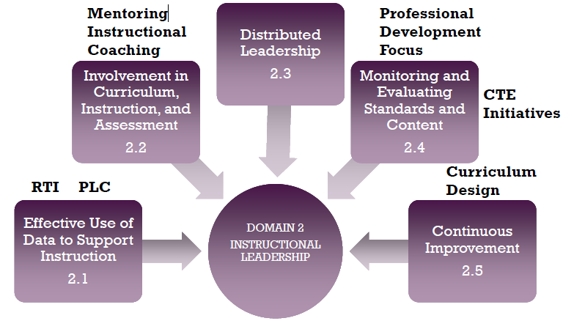
Domain Two
Instructional Leadership
Notes:
Instructional Leadership is the most heavily weighted Domain. Page 76 of PE Handbook lists the domain weights. Reminder, districts have the option to change the domain weights.

Slide 4
Effective Use of Data to Support Instruction
Domain 2.1
Notes:
When you look at the 5 components and really spend time, what becomes obvious is that Components 2-5 really can’t be properly implemented without first having addressed Component 2.1: Using Data to Support Instruction.

Slide 5
Effective Use of Data to Support Instruction Considerations
How do you plan to collect and use data to develop your school improvement plan?
What kind of processes, procedures, and protocols do you have in place to analyze school-wide data?
How do you ensure time for teachers to analyze and work with data to inform instruction?
Do you have a school leadership team, and, if so, how do you engage them in establishing a data driven school improvement plan?
How do you engage the leadership team in making plans for the future based on school-wide data?
What kind of professional growth do you provide for teachers and how is it connected to school-wide data and data about individual teachers?
Notes:
The goal does not have to be what the state recommends for yearly growth.

Slide 6
Effective Use of Data to Support Instruction
Level Comparison and Progression
Identifies essential data for data driven school improvement plan.
Develops processes, protocols to collect, interpret, and use data for instructional decisions.
Ensures time for teachers to work with data.
Articulates a clear vision for use of data to improve instruction.
BASIC
Engages leadership team in implementation of data driven SIP.
Connects instructional improvement to professional growth plans for school and teachers.
Provides a systematic approach and supports to foster a data-driven culture.
Provides targeted professional development based on individual teacher and school-wide data.
PROFICIENT
Engages leadership team in determining outcome of improvement goals and formulating strategies to meet or extend goals for the future.
Identifies innovational instructional practices and student interventions based on data analysis.
Encourages teachers to analyze data to identify student misconceptions in order to revise instructional approaches as needed.
DISTINGUISHED
Notes:
ACCOMPANYING 4.1 RUBRIC

Slide 7
Effective Use of Data to Support Instruction
Sample Artifact Progression
Data notebooks, Power Points or some other kind of organized compilation of essential data.
Processes/Protocols for collecting, using, and interpreting data.
Agendas or schedules as evidence of time provided to teachers.
School Improvement Plan clearly connected to data.
BASIC
Data notebooks, Power Points or some other kind of organized compilation of essential data.
Processes/Protocols for collecting using and interpreting data.
Agendas or schedules as evidence of time provided to teachers.
School Improvement Plan clearly connected to data.
Professional development plan based on teacher and school wide data
PROFICIENT
Data notebooks, Power Points or some other kind of organized compilation of essential data.
Processes/Protocols for collecting using and interpreting data.
Agendas or schedules as evidence of time provided to teachers.
School Improvement Plan clearly connected to data with plans to meet or extend the goals for the the future
Professional development plan based on teacher and school wide data
Evidence of how teachers us data to revise instructional strategies based on student misconceptions, i.e. observations, grade/subject level data meetings, lesson plans, etc.
DISTINGUISHED
Notes:
ACCOMPANYING 4.1 RUBRIC

Slide 8
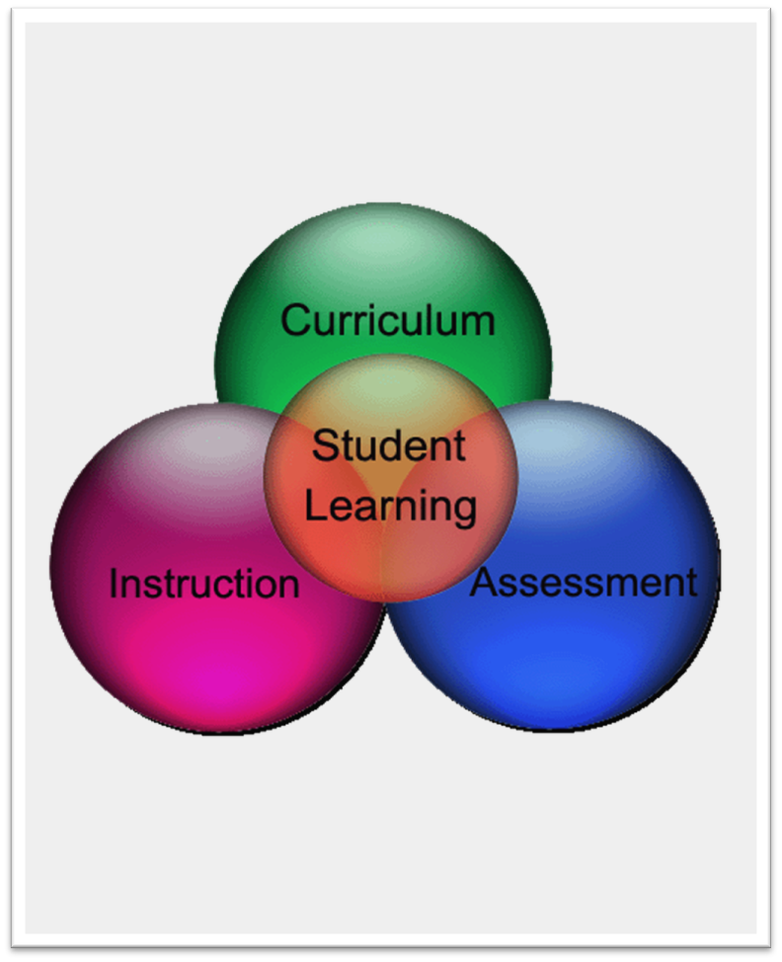
Involvement In Curriculum, Instruction, and Assessment
Domain 2.2

Slide 9
Involvement in CIA
Considerations
Do you and your leadership team develop a comprehensive School Improvement Plan?
How do you involve teachers in the development of rigorous and measurable goals for student achievement? i.e. SLO’s, grade level and/or content area goals?
How would you involve students in the development of rigorous and measurable goals for student achievement? You might consider looking at the Danielson Rubrics. At the Distinguished Level, the rubrics suggest student involvement in goal setting for their own learning.
How do you align individual teacher/student learning goals with the broader school wide improvement goals? For example, do all SLO’s align with the school wide goals for student achievement?
If you are a Focus/Priority school, how do your goals for student learning align with the Turn Around Principles?
What kind of professional growth have you developed or made available for your teachers? i.e. SD DOE Instructional Reading Coaching Program, MTSS, etc.?
How is your professional growth plan aligned with the School Improvement Plan and the goals for student learning?

Slide 10
Involvement in CIA
Level Comparison and Progression
(With teachers and students), establishes rigorous measurable goals for every student.
Is actively involved in helping teachers implement research-based instruction.
Provides planning time and PD on CIA implementation.
Develops master schedule to include time for teacher planning and professional development.
BASIC
Systematically monitors progress of student learning using both formative and common assessments.
Monitors and evaluates fidelity of implementation through protocols for collecting, analyzing and reporting data.
Develops and executes a specific and targeted plan for CIA professional development informed by multiple sources of data.
PROFICIENT
Leverages leadership team to analyze multiple data sources for CIA priorities.
Adds value to district by exemplifying professional growth, collaborating with colleagues, and sharing work that yields high measures of teacher and student productivity.
Establishes tools such as data walls, notebooks, or easily generated data reports to track student progress.
DISTINGUISHED
Notes:
ACCOMPANYING 4.1 RUBRIC

Slide 11
Involvement in CIA
Sample Artifact Progression
Documentation of rigorous measurable goals, i.e. SIP, SLO process
Documentation of teacher and student involvement in the goal setting process, i.e. agendas or observation of process by evaluator, SLO process, data retreat/chats
Examples of formative feedback to teachers, i.e. Teachscape and/or written samples
Master schedule with plan time
Schedule of professional development aligned with goals
BASIC
Data notebooks, logs, agendas reflecting systematic monitoring of student growth through common and/or formative assessments
Protocols for collecting, analyzing, and reporting data, i.e. PLC structure
School improvement plan reflecting a specific and targeted plan for CIA professional development
PROFICIENT
Agendas reflecting involvement of leadership team in analyzing multiple data sources for CIA priorities
Evidence of participation in professional growth opportunities, and collaboration with colleagues, i.e. PLC, grade level team meeting, etc.
Data notebooks, data walls, Google docs, Indistar etc. as tools to track student progress
DISTINGUISHED

Slide 12

Distributive Leadership
Domain 2.3

Slide 13
Distributive Leadership
Considerations
What kind of leadership opportunities do you provide for staff?
Do you facilitate or make accessible to your staff mentoring programs that promote leadership?
When you delegate leadership tasks to staff, do you give them the authority to successfully complete the task?
How do you monitor progress and completion of delegated tasks?
How do you recognize and/or celebrate staff members who seek out leadership responsibilities?
How do you work with staff in fashion that develops their ability to manage tasks and responsibilities?
How are you tying the leadership discussion with the Danielson Model, particularly Domain 4: Professional Responsibilities?
Have you considered involvement in the South Dakota DOE Instructional Coaching program as a way not only to strengthen instructional practice but also to strengthen the leadership skills of both the principal and the teachers involved?
Notes:
Question 6: Regularly meeting with grade level or content area teams to discuss and monitor progress with delegated tasks and responsibilities.

Slide 14
Distributive Leadership
Level Comparison and Progression
Provides opportunities to mentor some emerging leaders.
Provides moderate support and encouragement of leadership by assignment of staff to existing leadership positions.
Occasionally seeks out staff for increased responsibilities based upon experience, qualifications, and/or performance.
Monitors completion of delegated tasks but not progress towards completion.
BASIC
Provides opportunities to mentor all emerging leaders.
Promotes leadership and growth through the creation of and assignment to leadership positions.
Consistently seeks out staff for increased responsibilities based upon experience, qualifications, and/or performance.
Monitors progress for completion and success.
PROFICIENT
Systematically provides opportunities for emerging leaders to distinguish themselves and gives them the authority to complete the task.
Recognizes and celebrates emerging leaders.
Encourages and supports staff to seek out responsibilities.
Monitors and supports staff in a fashion that develops their ability to manage tasks and responsibilities.
DISTINGUISHED
Notes:
ACCOMPANYING 4.1 RUBRIC

Slide 15
Distributive Leadership
Sample Artifact Progression
List of teacher leadership roles or delegated tasks within the school.
Evidence of monitoring of completion of delegated tasks, i.e. agendas and/or other work products, logs, meeting with teams.
Evidence of how principal mentors teacher leaders, i.e. formative feedback samples, agendas of trainings, logs of mentoring time with teacher leaders.
Evidence through Danielson: Domain 4, i.e. evaluations.
BASIC
Evidence that all emerging leaders have leadership and growth opportunities, i.e. a systematic and ongoing plan developed and led by a teacher team.
Evidence of monitoring of progress and completion of delegated tasks, i.e.. agendas and/or other work products, logs, meeting with teams.
Evidence of how principal mentors teacher leaders, i.e. formative feedback samples, agendas of trainings, logs of mentoring time with teacher leaders.
Evidence through Danielson: Domain 4, i.e. evaluations.
PROFICIENT
A systematic process in which emerging leaders are recognized and given the authority to lead, i.e. mentoring and/or leadership program, SD Instructional Coaching, an ongoing plan developed and led by a teacher team.
A systematic process for recognition and celebration of emerging leaders.
Training that develops the ability of staff to manage tasks and responsibilities
Evidence of Danielson: Domain 4.
DISTINGUISHED

Slide 16
Distributive Leadership Opportunities
Teachers as mentors-both local and state
Teachers as literacy or math leaders
Teachers as coaches, i.e. SD DOE Coaching Program for Reading
Support of teachers as members on committees both local, state, and national, i.e. curriculum, instructional council, hiring, etc.
Department chairpersons; grade level leaders
District and school level leadership teams, i.e. PBIS teams, data teams, PLC teams, BLT
Internship opportunities
Participation in programs both internal and external that support aspiring leaders, i.e. MAPLE’s yearly Aspiring Leaders program, Porthan training, SD DOE Coaching for Reading
Support and encouragement of teachers seeking National Certification
Notes:
The goal does not have to be what the state recommends for yearly growth.

Slide 17

Monitoring and Evaluating Standards and Content
Domain 2.4

Slide 18
Monitoring and Evaluating Standards and Content
Considerations
How do you monitor and ensure the alignment of the implemented curriculum with the intended curriculum?
How do you ensure adequate instructional time to cover the content of the intended curriculum at the appropriate depth, i.e. scheduling, mitigation of interruptions, etc.?
Have your worked with staff or provided staff with appropriate supports to develop pacing guides?
The PE rubric (2.4) uses the term experienced curriculum. What does that mean? How do you and your leadership team analyze data from the experienced curriculum? How do you connect the experienced curriculum to the implemented curriculum to the intended curriculum? What are you and your leadership team able to learn from making those connections?
How will you connect and use the teacher evaluation process (Danielson model) to the monitoring and evaluating of standards and content.
How do you work with teachers to ensure teaching is at the appropriate depth?
If you have had the Porthan training or are currently enrolled in the training, how would you use the skills learned from the training to more effectively monitor standards and content?
How will you connect the monitoring and evaluating of standards to your work with the Turn Around Principles (if applicable)?
Notes:
Get out Porthan notebook!!!

Slide 19
Monitoring and Evaluating Standards and Content
Level Comparison and Progression
Ensures alignment of the implemented curriculum with the intended curriculum.
Ensures that teachers have time to cover content at the appropriate depth.
Implements systems that eliminate or minimize interruptions or distractions from instructional time.
BASIC
Systematically monitors the implemented curriculum to ensure alignment with intended curriculum.
Systematically monitors whether teachers are on schedule to teach intended curriculum and at the appropriate depth.
Ensures teachers are aware of appropriate pacing needed to address all standards.
PROFICIENT
Collaborates with school leadership team to analyze data from the experienced curriculum to make adjustments so that the implemented curriculum aligns with the intended curriculum.
Collaborates with teachers to review alignment to ensure appropriate depth of teaching.
DISTINGUISHED
Notes:
ACCOMPANYING 4.1 RUBRIC

Slide 20
Monitoring and Evaluating Standards and Content
Sample Artifact Progression
Both formative and summative classroom observations as evidence of monitoring alignment between intended curriculum and implemented curriculum.
Pacing guides as evidence that teachers have time to cover intended curriculum.
Schedules as evidence of maximizing instructional time and mitigating interruptions.
BASIC
Schedules and logs of regular formative/summative classroom observations as evidence of monitoring alignment between intended curriculum and implemented curriculum.
Evidence through regularly scheduled observations, grade level/content area meetings, etc. that teachers are on schedule to teach intended curriculum and at the appropriate depth.
Pacing guides provided to teachers and/or developed by teachers.
PROFICIENT
Data (formative and/or summative) from the experienced curriculum as evidence of alignment between intended curriculum and implemented curriculum, i.e. data from SLO’s, Dibbles, district assessments, ongoing formative assessments, etc.
Evidence of collaboration with teachers, both individually and collectively to ensure depth of teaching, i.e. formative observations, grade level/content level meetings to look at data and discuss strategies.
DISTINGUISHED

Slide 21
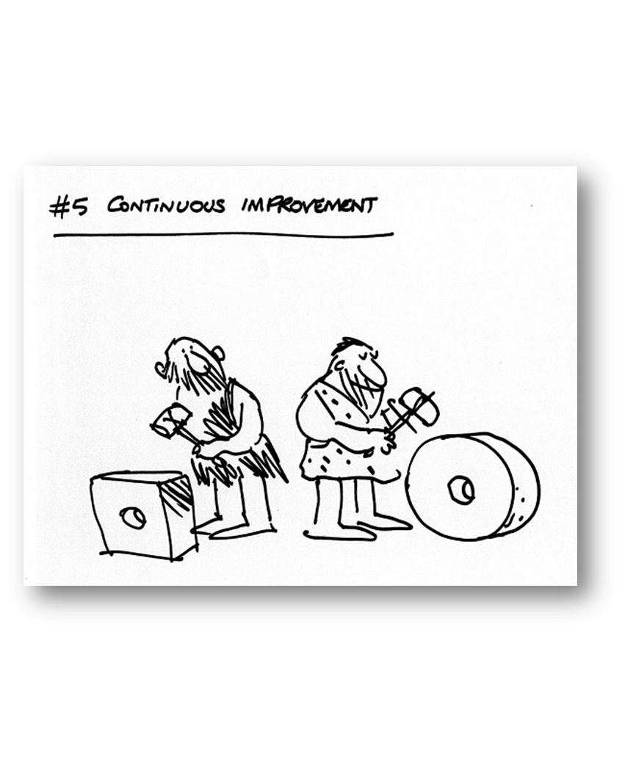
Continuous Improvement
Domain 2.5

Slide 22
Continuous Improvement
Considerations
For this component, please refer to the consideration slides for the previous four components.
Do you have a professional growth plan?
How do you use data to plan for professional development?
How do you access and provide training for research based instructional strategies?
Notes:
The goal does not have to be what the state recommends for yearly growth.

Slide 23
Continuous Improvement
Level Comparison and Progression
Analyzes data and uses results for professional growth plans.
Draws on research of improvement strategies in the development of professional growth plan.
Ensures staff has access to research-based PD opportunities to enhance both instructional and leadership skills.
BASIC
Uses multiple sets of data in the collaborative development of professional growth plans.
Applies effective and continuous improvement strategies in the implementation of professional growth plans.
Encourages and supports staff participation in professional development opportunities.
PROFICIENT
Includes both short-term and long-term goals and objectives in the professional growth plan.
Provides models of effective practice as part of the professional growth plan.
DISTINGUISHED
Notes:
ACCOMPANYING 4.1 RUBRIC

Slide 24
Continuous Improvement
Sample Artifact Progression
Evidence that professional growth plans/needs are related to school data, i.e. coaching programs focused on specific literacy and/or math needs or mentoring programs related to graduation rate data
Evidence of research as basis for professional growth plan
Professional development plan that includes opportunities to enhance both leadership and instructional skills
BASIC
Evidence that professional growth plan is based on multiple sets of data, i.e. coaching programs focused on specific literacy and/or math needs; mentoring programs related to graduation rate data; PBIS training related to discipline data
Communications/Actions that encourage and support staff participation in professional development opportunities, i.e. Memos, intentional scheduling of PD, engagement of teachers in individual self-reflection about professional growth (Danielson 4.d and 4.e)
PROFICIENT
Evidence of short-term and long-term goals and objectives in the professional growth plan.
Models of effective practice as part of the professional growth plan, i.e. Instructional Coaching (DOE), mentoring programs, PBIS, Aspiring Leaders, internships, Porthan Training, Socratic Seminar, inquiry math training, Reading Recovery and other research based literacy programs, CPM (College Preparatory Math), training for STEM and CTE based programs, etc.
DISTINGUISHED

Slide 25
Domain 2
Sample Artifact List
    Progress on school goals and school improvement plans
    Stakeholder surveys
    School improvement plans
    Minutes of planning sessions
    Formative reviews/feedback
    School/staff meeting agendas
    Goal setting statements
    Student Learning Objectives (SLOs)
    Data notebooks/data retreats/data walls
    Teacher action research
    Records of involvement in professional organizations and activities

Slide 26
Domain 2
Sample Artifact List
    Teacher lesson plans
    Schedules and meetings of professional learning communities
    Curriculum maps aligned to domains
    Changes in curriculum and instruction based on student data
    Documentation of instructional practices used in the school
    Teachers’ professional learning opportunities
    School web site
    Mentoring/Internships
    Principal professional growth plan

Slide 27
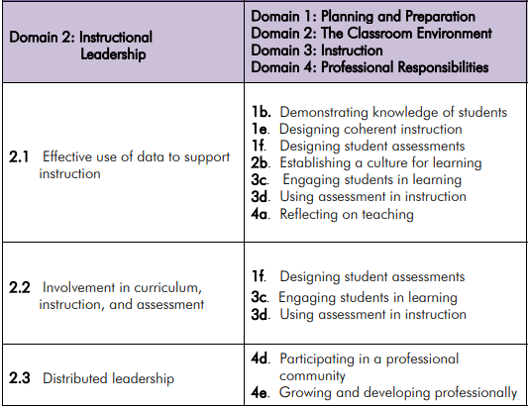
Domain 2
PE to TE Crosswalk

Slide 28
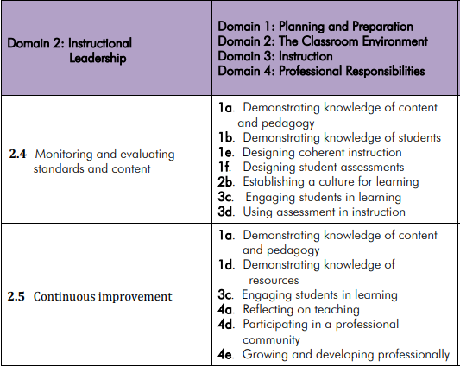
Domain 2
PE to TE Crosswalk

Slide 29

Principal Effectiveness Comparison to Turnaround Principles
https://doe.sd.gov/Effectiveness/documents/PE-turnaround.pdf

Slide 30

Principal Effectiveness Tools
https://doe.sd.gov/Effectiveness/Principal.aspx

