Slide 1
RESULTS DRIVEN ACCOUNTABILITY

Slide 2
TODAY’S OBJECTIVES & NORMS
Objectives
Review and analyze multiple data sets
Determine data progression/connection statements
Determine priority challenges from data analysis
Complete a root cause analysis
Develop goals
Develop an action plan
Norms
Listen with Engagement
Honor Confidentiality of Data
Honor Private Think Time
Everyone has a Voice
Be Respectful of All Comments
Take Care of Your Needs
Do Not Take it Personally

Slide 3
RDA GOALS

Slide 4
RDA GOALS

Slide 5
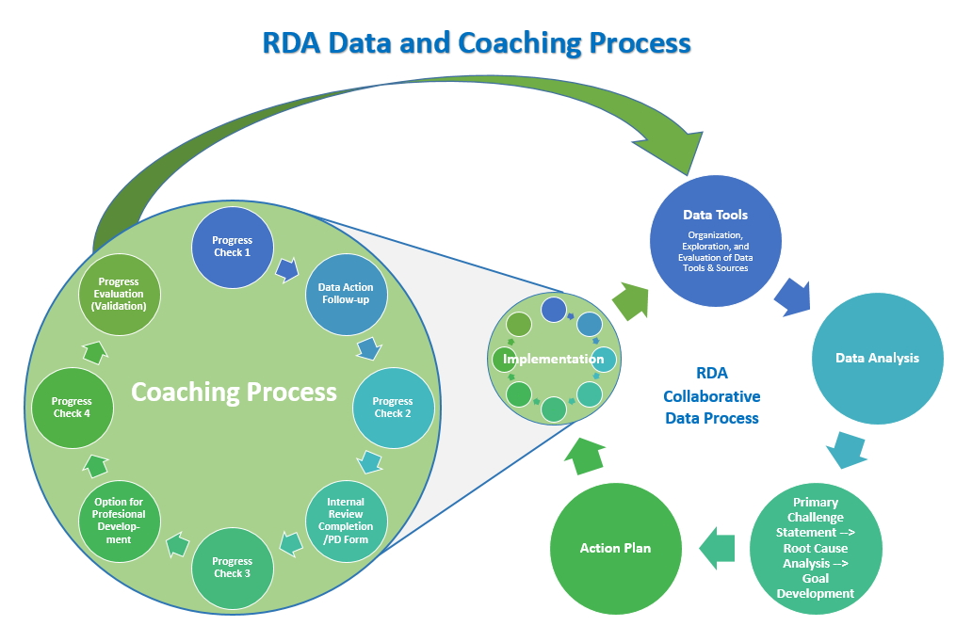
BRIEF OVERVIEW OF FLOW OF RDA PROCESS
Notes:
Give big picture overview of the data retreat

Slide 6
ROLES AND NAVIGATION FOR DATA ANALYSIS
Idea for large groups
Break into small groups
Analyze
Return to large group to discuss and summarize on template
Assign one team recorder
Keep all involved
Assign specific data sets to team members
Keep discussions for template at building level

Slide 7
INTERACTIVE TEMPLATE TIPS
All buildings using same template
It’s important to stay in your own row
Having recorder helps control this
If the box turns gray, someone is typing in that cell
If you accidentally type over someone else, click out of cell and click undo
As we are analyzing the data, check for similarities
Possible areas for cross building collaboration

Slide 8
YEAR 1 SIGN-IN AND REFLECTION
Sign-in and answer reflection questions
The purpose of this is to get everyone into data analysis ‘mode’ and start to function as a data team.

Slide 9
YEAR 2 & 3 SIGN-IN AND REFLECTION
Sign-in and answer reflection questions
The purpose of this is to get everyone into data analysis ‘mode’ and start to function as a data team.
Review Last year’s Goal, Action Plan and Validation (linked on your agenda)
Document any discussion on the data analysis template, and then answer the remaining reflection questions.

Slide 10
SPP Data Tree
Notes:
Show everyone, particularly gen. Ed., how everything is interconnected and how their roles all impact students on IEPs
*all students are ALL of our students

Slide 11
If…Then… Warm Up Activity
If my pet could talk, then…
If my friend orders pineapple on our pizza, then…
If I could breathe underwater, then…
If my favorite movie was real life, then…

Slide 12
Risk Analysis Rubric Sample
Notes:
Not deep analysis - just giving big picture before looking into each indicator
Quick walk through of each area

Slide 13
“WHY ARE WE HERE”
Risk Analysis Rubric
This tab guides you through analyzing the Risk Analysis Rubric, which provides an overview of your district’s scores.
Can your team explain what each of these indicators are? If not, there are indicator TA sheets linked within each indicator’s tab and ask your RDA Coach any questions you might have. *Please note: these sheets are currently being updated, so some have not been included.
Team share out: Are there any question or concerns about this data set?
Notes:
Show how TA guides are linked on template to tell them where data comes from, how it’s calculated, etc.
*Remember that detailed indicator report includes alt assessment scores, Susan reports do NOT
Look at the target that was 18-19 and then look at the target 19-20, what was the difference
Issues with Ind. 3 Reports:
19-20 new target was set, these targets are lower than previous targets
On risk rubric 19-20 target shows up, 18-19 target was higher, so 18-19 scores might meet 19-20 target but they still got "docked" because the 18-19 target scores were higher
Look at 18-19 target and then at the 19-20 target

Slide 14
“WHO ARE OUR STUDENTS”
SPP/APR Reports
This tab guides you through analyzing a couple of data sets regarding
Required Data Sets:
Big Picture - Data Drill-Down 2A and Snapshot 2 and 3
This tab guides you through analyzing SPP/APR Reports.
This data comes from SPP/APR Indicator data and Dec. 1 Child Count
Notes:
Much like an IEP, we’re going to be using these data pieces to help inform our action plan - so refer to that specific data

Slide 15
DATA PROGRESSION
If your team were to select a piece of data from this section for a goal, what data piece stood out to you? Write it in a data statement (23% of students are in the general education classroom)
How does this data connect back to "Why Are We Here?"
What are some possible action steps that could be taken to impact this data?
What would be the overarching goal you're hoping to impact with these action steps?
Notes:
Much like an IEP, we’re going to be using these data pieces to help inform our action plan - so refer to that specific data

Slide 16
INDICATOR 1: GRADUATION RATES
This tab guides you through analyzing a couple of data sets regarding Indicator 1: Graduation Rates in your district.
Data Sets:
Snapshot 7, Data Drill-Down 7A - SPP/APR
Early Warning Report - SD-STARS (this data comes from Infinite Campus)
Notes:
Susan Report for Indicator 2: Denominator = child count Dec. 1, numerator = any student who dropped out in the school year - might make data look off because numerator is from previous school year
i.e. - if looking at Dec. 1, 2020 child count, numerator is drop out number for 2019-20 school year

Slide 17
DATA PROGRESSION
If your team were to select a piece of data from this section for a goal, what data piece stood out to you? Write it in a data statement (23% of students are in the general education classroom)
How does this data connect back to "Why Are We Here?"
What are some possible action steps that could be taken to impact this data?
What would be the overarching goal you're hoping to impact with these action steps?

Slide 18
INDICATOR 3: SD ASSESSMENT SCALE SCORES AND TARGETS
This tab guides you through analyzing a couple of data sets regarding Indicator 3: SD Assessment Targets in your district.
Data Sets:
Indicator 3 - Quick Look Report 4A for all grades - SPP/APR
SD Assessment Scale Scores - SD Assessment Portal
SD Assessment Targets - SD Assessment Portal
Both organized by Grade Level for ELA & Math
Targets are comparing performance on each target to the performance on the test as a whole in the district - so a “+” for a target means students performed better on that target compared to the test as a whole

Slide 19
Tools for Teachers

Slide 20
DATA PROGRESSION
If your team were to select a piece of data from this section for a goal, what data piece stood out to you? Write it in a data statement (23% of students are in the general education classroom)
How does this data connect back to "Why Are We Here?"
What are some possible action steps that could be taken to impact this data?
What would be the overarching goal you're hoping to impact with these action steps?

Slide 21
INDICATORS 6 & 7: PREK LRE & ACQ. OF K AND S
This tab guides you through analyzing a couple of data sets regarding Indicators 6 & 7: Child Outcomes Summary.
Data Sets:
Data Drill Down 8A and Snapshot Report 8 - SPP/APR
Data Drill-Down 9A & Snapshot Report 9 - SPP/APR
Indicator 7 Child Outcomes Summary - SD-STARS (this data comes from Infinite Campus)
Children with No Assignments - SD-STARS (this data comes from Infinite Campus)
If you have questions, refer to the TA guide linked on the data analysis template.

Slide 22
DATA PROGRESSION
If your team were to select a piece of data from this section for a goal, what data piece stood out to you? Write it in a data statement (23% of students are in the general education classroom)
How does this data connect back to "Why Are We Here?"
What are some possible action steps that could be taken to impact this data?
What would be the overarching goal you're hoping to impact with these action steps?

Slide 23
INDICATOR 14C: POST-SCHOOL OUTCOMES
This tab guides you through analyzing a couple of data sets regarding Indicator 14c: Post-Secondary Outcomes. This exiter data is reported by the district - students are contacted by either the district or BHSU a year following exiting the district.
Data Sets:
Longitudinal Report - Indicator 14 Site

Slide 24
DATA PROGRESSION
If your team were to select a piece of data from this section for a goal, what data piece stood out to you? Write it in a data statement (23% of students are in the general education classroom)
How does this data connect back to "Why Are We Here?"
What are some possible action steps that could be taken to impact this data?
What would be the overarching goal you're hoping to impact with these action steps?

Slide 25
GOAL PRE-WORK
This tab guides you through compiling all of your findings so far. Considering all of the data you’ve analyzed so far, answer the Goal Pre-Work questions.
After these pre-work discussions, complete the If…Then… activity.
Examples might include:
If students are not meeting [target], then district needs…
If teachers don’t have access to training for [insert topic], then…

Slide 26
SMART GOAL PRE-WRITING
After these pre-work and if…then… discussions, complete the SMART goal section:
Specific - what specifically is your team wanting to impact?
Measurable - what are you going to use to measure the progress of this goal?
Achievable - what would be an achievable change for your team within your chosen timeline? (indicator measurement considers at least 2% to be growth)
Relevant - what is the relevance of working towards this improvement?
Time-bound - what is the timeline for completing this goal? (set for at least 3 years from now)

Slide 27
GOAL PRE-WORK
SMART Examples:
Specific - We want to increase our district SD General Assessment proficiency scores - currently at 11% for Math and 13% for ELA
Measurable - SD General Assessment scores
Achievable - We want to increase our proficiency rates by a minimum of 5%
Relevant - Improving ELA and Math outcomes for our students
Time-bound - We want to achieve this by Spring of 2025

Slide 28
PARAPROFESSIONAL SURVEY
This tab guides you through analyzing the results of the perception survey sent out to certified staff.
Data Sets:
Paraprofessional Survey Results

Slide 29
PERCEPTION SURVEY
This tab guides you through analyzing the results of the perception survey sent out to certified staff.
Data Sets:
Perception Survey Results
For Year 2 & 3 Schools: Perception Survey Comparison

Slide 30
DATA PROGRESSION
If your team were to select a piece of data from this section for a goal, what data piece stood out to you? Write it in a data statement (23% of students are in the general education classroom)
How does this data connect back to "Why Are We Here?"
What are some possible action steps that could be taken to impact this data?
What would be the overarching goal you're hoping to impact with these action steps?

Slide 31
SYSTEMIC COLLABORATIVE DATA PROCESS:
ROOT CAUSE ANALYSIS

Slide 32
ROOT CAUSE ANALYSIS:
OVERVIEW

Slide 33
ROOT CAUSE ANALYSIS
Probable Root Cause
Not definitive until affected
Monitoring and Evaluation Required
A Root Cause Analysis is a method to explore a problem in a systematic way to gain a consensus about what most likely is causing the problem and what course of actions should be taken. Once a “cause” has been identified, there is a realistic hope that it can be reduced or dissolved in the future – Preus 2003

Slide 34
ROOT CAUSE ANALYSIS OVERVIEW
Connect Data Progression with Data Analysis
Develop Priority Challenge Statement
Circle Map Activity
ICEL Activity
Root Cause Validation
Goal Writing
Strategies Input Gallery Walk
Develop Building Action Plans

Slide 35
CONSENSUS
Root Cause Analysis activities will be done in building teams
What is consensus to your team?
Notes:
Kyle
Make sure teams are appropriately assigned – is there administer per team? Building teams…
Difficult with larger teams coming to decision. (thumbs – Thumbs up – agree, Thumbs sideways – can live with it, Thumbs Down – cannot move forward with it)
Have districts discuss what it means for consensus (can people live with that vs. cannot move forward with that)

Slide 36
Root Cause Analysis:
CHALLENGE STATEMENT
Notes:
Handout ?

Slide 37
WHAT IS A CHALLENGE STATEMENT?
Drawn from trends that are a concern for the school/district
Should be specific statements about student performance
Provide the strategic focus for improvement efforts
Challenge Statements are NOT what caused the performance
Statements of what the performance IS
Root causes are always focused on at least one challenge statement

Slide 38
CHALLENGE STATEMENT
Based on your Data Progression Connection
2-3 Data points that can be related to each other
Write an overall challenge statement connecting all data used
Example: We have 14% more students in the resource room placement compared to the state average. Our staff was 10% lower in agreement to the district percentage in regards to implementing students accommodations and modifications effectively.

Slide 39
CIRCLE MAP ACTIVITY – STEP 1
One Circle Map poster paper for each challenge statement
Smallest circle – write priority challenge statement
Larger Circle – List All Possible Explanations for Challenge statement
Use Sticky Notes
Capture ALL Voices
More is better
Explanations will guide towards a Root Cause

Slide 40
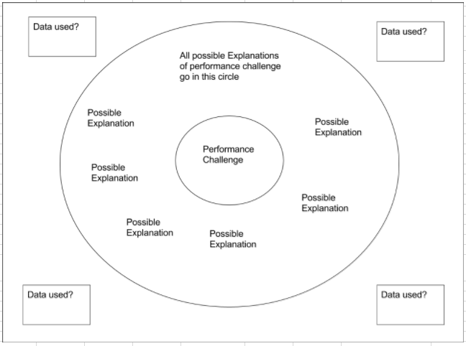
Performance Challange

Slide 41
ICEL ACTIVITY
As a team, organize all sticky notes into the following four categories of factors:
Instruction
Curriculum
Environment
Learner
To help do determine which categories, these questions may be helpful:
ICEL Supporting Questions Document
Once sorted, consider if there’s an area that needs more “attention.”

Slide 42
CIRCLE MAP ACTIVITY – STEP 2
Building team – Select 2 “Best” Explanations
Remove explanations:
Similar/duplicates
Things we cannot change
Outside the schools circle of influence
Opinions
Not based on data or data cannot support it
Can not be tested or verified
Keep explanations:
Things we can change or impact (instructional strategies)
Within the schools circle of influence (district curriculum/interventions)
Supported by data

Slide 43
Root Cause Analysis:
DISCOVERING A ROOT CAUSE
Notes:
Handout ?

Slide 44
WHEN IS A ROOT CAUSE, A ROOT CAUSE?
Criteria: Root cause or Contributing Cause?
Would the problem have occurred if this cause had not been present?
Will the problem reoccur even if the cause is corrected?
If you answer no to both questions, this is a possible root cause.
If yes to either question, then it is a contributing cause.
Ammerman 2012
Can be difficult, if not impossible to identify a single, specific cause

Slide 45
DETERMINING POSSIBLE ROOT CAUSE
Looking at the causes selected from the Circle Map activity, ask yourselves the following questions:
Would the problem have occurred if this cause had not been present?
Will the problem reoccur even if this cause is corrected?
If you answer “no” to both questions, this is your possible true root cause.
If you answer “yes to either or both of these questions, ask yourselves why this cause might be happening, and then ask yourselves the questions again.

Slide 46
Root Cause Analysis:
GOAL WRITING

Slide 47
GOAL WRITING
Remember your SMART Goal Pre-Work:
Specific
Measurable
Achievable
Relevant
Time-Bound
Use your Challenge statement and two root causes to update these SMART pieces and write a draft goal.

Slide 48
GOAL WRITING
Examples:
Priority Challenge Statement: In the perception survey, 22% of the staff said that they did not fully understand how to effectively implement modifications and accommodations, and current proficiency rates across the district are 16% for ELA and 11% for Math
Goal: By the Spring of 2025, we will increase SD General Assessment proficiency rates by a minimum of 5% in both ELA and Math.
Potential Action Steps:
Provide professional learning for teachers regarding accommodations and modifications
Review current LRE placements and consider how to increase inclusion
Notes:
*Match examples

Slide 49
ROOT CAUSE ANALYSIS:
STRATEGIES INPUT GALLERY WALK
Notes:
Handout ?

Slide 50
STRATEGIES INPUT GALLERY WALK
Write the goal on the top of your poster paper
Using sticky notes:
Write down ANY - idea, task, comment, question, strategy, intervention, anything that you feel could positively impact or “move the needle” forward!
Gallery walk w/sticky notes – each individual writes their own
Write sticky notes for your goal and all other teams

Slide 51
STRATEGIES INPUT GALLERY WALK
Back with your Building…
Review and organize sticky notes
Review previous solutions/strategies on template
Discuss strategies
Document these on data analysis template when done

Slide 52
ROOT CAUSE ANALYSIS:
ACTION PLANNING

Slide 53
ACTION PLAN
Use Strategies to Develop Action Plan
Input action steps, completion dates, person responsible, evidence

Slide 54
NEXT STEPS
Complete action plan for the remainder of year
Mark deadlines
Include ideas from strategies input gallery walk
Include contact person responsible for every action step
Discuss and plan out first steps in more detail with RDA Coach(es)
Determine roles and responsibilities for first steps with RDA Coach(es)
Schedule next meeting date with RDA Coach(es)
Discuss what meeting will be about - is someone going to create an agenda?
Communicate any additional need/supports with RDA Coach(es)
If time, begin to develop/complete first action steps

